Slide 1

Model for single species with pH feedback
$\frac{dn}{dt}=αn\left(1−\frac{n}{K}\right)Γ\left(p\right) Γ\left(p\right)=1−\frac{1−e^{−\frac{{\left(p−p_{opt}\right)}^{2}}{2σ^{2}}}}{1−e^{−\frac{{\left(p_{c}−p_{opt}\right)}^{2}}{2σ^{2}}}}$ $\frac{dp}{dt}=αb_{1}\frac{dn}{dt}Θ\left(\frac{dn}{dt}\right)+αb_{2}n$
Dilution: x100. At dilution, set $p=1$.
Gamma_p = @(p,p_opt,pc,sig2) ...
1 - (1-exp(-(p-p_opt).^2/2./sig2))./( 1-exp(-pc^2/2./sig2) );
dn_dt_direct = @(n,al,alp_mat) al*n.*(-alp_mat*n);
dn_dt_p = @(n,p,al,K,p_opt_vec,pc,sig2) al*n.*(1-sum(n)/K).*Gamma_p(p,p_opt_vec,pc,sig2);
dn_dt = @(n,p,al,K,p_opt_vec,pc,sig2,alp_mat) ...
dn_dt_p(n,p,al,K,p_opt_vec,pc,sig2) + dn_dt_direct(n,al,alp_mat);
dp_dt = @(n,p,b1,b2,al,K,p_opt_vec,pc,sig2) al*b1*sum( dn_dt_p(n,p,al,K,p_opt_vec,pc,sig2).*...
(dn_dt_p(n,p,al,K,p_opt_vec,pc,sig2)>0) ) + al*b2*sum(n);

Slide 2
Interactions only via pH, neutral community (S=2)

Slide 3
Dynamics can bifurcate into limit cycles

Slide 4
Other parameter values: full route to chaos

Slide 5
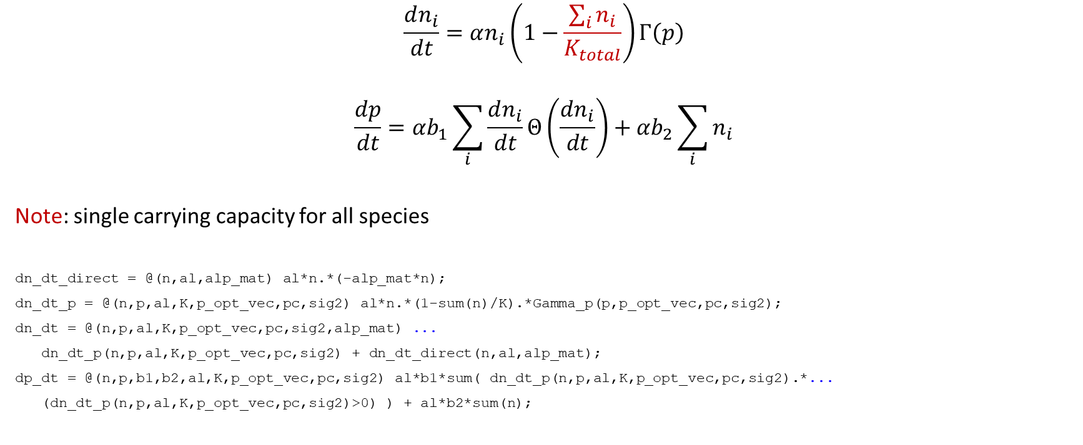
Interactions only via pH, neutral community
$$\frac{dn_{i}}{dt}=αn_{i}\left(1−\frac{\sum_{i}{n_{i}}}{K_{total}}\right)Γ\left(p\right)$$ $$\frac{dp}{dt}=αb_{1}\sum_{i}{\frac{dn_{i}}{dt}Θ\left(\frac{dn_{i}}{dt}\right)}+αb_{2}\sum_{i}{n_{i}}$$
Note: single carrying capacity for all species
dn_dt_direct = @(n,al,alp_mat) al*n.*(-alp_mat*n);
dn_dt_p = @(n,p,al,K,p_opt_vec,pc,sig2) al*n.*(1-sum(n)/K).*Gamma_p(p,p_opt_vec,pc,sig2);
dn_dt = @(n,p,al,K,p_opt_vec,pc,sig2,alp_mat) ...
dn_dt_p(n,p,al,K,p_opt_vec,pc,sig2) + dn_dt_direct(n,al,alp_mat);
dp_dt = @(n,p,b1,b2,al,K,p_opt_vec,pc,sig2) al*b1*sum( dn_dt_p(n,p,al,K,p_opt_vec,pc,sig2).*...
(dn_dt_p(n,p,al,K,p_opt_vec,pc,sig2)>0) ) + al*b2*sum(n);

Slide 6
Interactions only via pH, neutral community (multiple species)
Fluctuations and chaos without extinctions
Can generate fluctuations even if single-species don’t fluctuate
Cannot generate chaos unless at least one of the species is chaotic (as far as I’d seen)

Slide 7
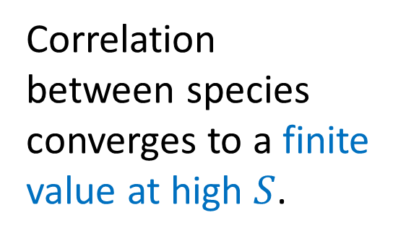
Correlations between species (interaction via pH only)
Correlation between species converges to a finite value at high $S$.

Slide 8

With different pH response between species
$$Γ\left(p\right)→Γ_{i}(p)$$
S = 60;
b1 = 3;
b2 = b1/3; pc = 0.6; sig2 = 1;
K = 1;
al = 1;
p_opt_vec = 1.4*ones(S,1)+0.3*randn(S,1);

Slide 9
Continuous pH model?
Might be more amenable to analytical approaches
Need to find a good model + good parameters (that will make a mess…)

Slide 10
Possible directions for project
Study model with daily dilution
Find dimensionality of dynamics
What happens beyond the “market mode”
Correlation between species
Other models
Effect of direct interactions on model
Might be able to proceed analytically??
Find a continuous model?
Other relations, links, directions
Relation (inspiration from..) to Hamiltonian MF model
Other situations where there is a “hub” structure

